Slide 1

AI-Powered Feedback Miner and Action Recommendation Engine
Group 1
Architecture, Technology & Design Overview

Slide 2
AI-Powered Feedback Miner
RAG + intelligent grading capstone project
Ingest Feedback
Evaluate feedback sentiment and urgency
Clustering and Labelling
Action Recommendation
Metrics Calculation
Identify Feedback sentiment and urgency score
Evaluate the theme of the feedback and cluster similar issues. Label them appropriately.
Open AI Recommendation Engine. Calculate the usefulness score.
Calculate theme relevance, clustering precision and action recommendation usefulness.
Ingest feedback from user from multiple sources
© 2026 NTT DATA, Inc.
1

Slide 3
1. What the app does
Feedback is collected and analyzed
AI identifies recurring themes
Action recommendations are generated
Customer comments, complaints, and survey responses are uploaded into the system for intelligent processing and categorization.
The OpenAI-powered analysis engine clusters similar issues, labels recurring themes, and detects high-impact customer concerns.
The system recommends improvement actions, prioritizes business issues, and produces structured analytics for decision-making.
Feedback Processing:
Upload Feedback → Preprocess Data → Cluster Similar Issues → Label Themes → Store Results
AI Analysis:
Retrieve Feedback → OpenAI Analysis → Impact Evaluation → Generate Recommendations → Analytics
Management Workflow:
Review Themes → Validate Recommendations → Track Insights → Export Reports
Workflow
© 2026 NTT DATA, Inc.
2

Slide 4
2. Technology design & improvements
Core stack
Why the design is strong
ASP.NET core web API
Backend API development
Modular Agentic AI workflow
Scalable ASP.NET Core architecture
OpenAI API
Theme detection & recommendation generation
OpenAI-powered semantic analysis
VS code
Development environment
Structured recommendation engine
SQL – based centralized data management
SQL server/SSMS
Feedback & analytics data storage
Enterprise ready API design
Swagger
API testing & validation
C# console application
Processing & orchestration workflows
GitHub
Version control & collaboration
Next improvements
Real-time feedback streaming • Cloud deployment using Azure • Multilingual feedback processing • Predictive customer analytics • Vector database integration • BI tools integration
© 2026 NTT DATA, Inc.
3

Slide 5
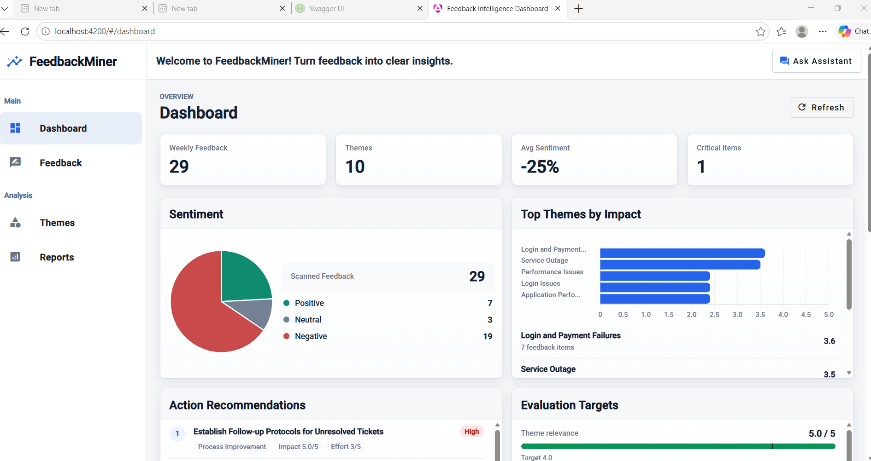
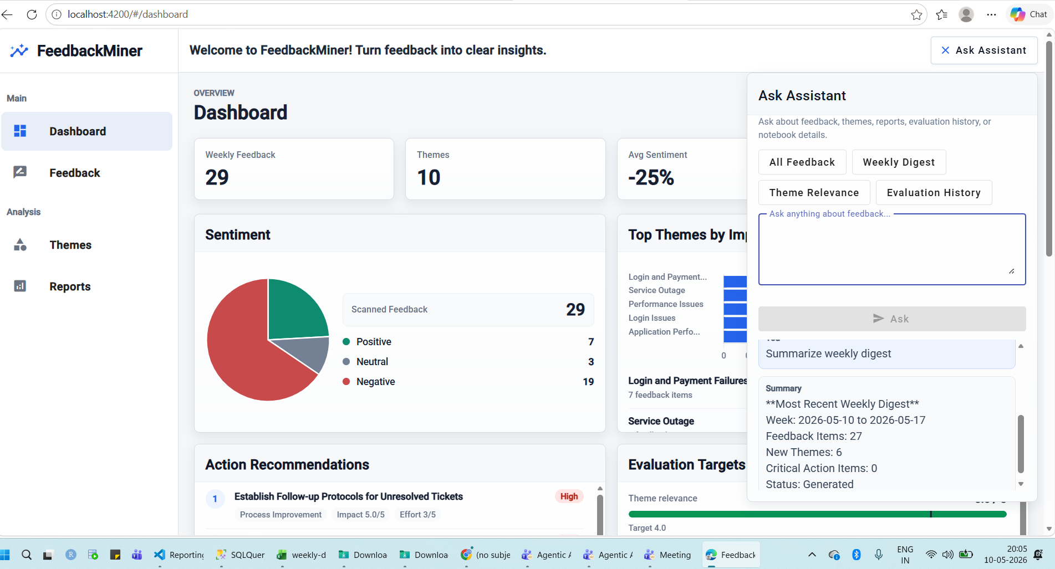
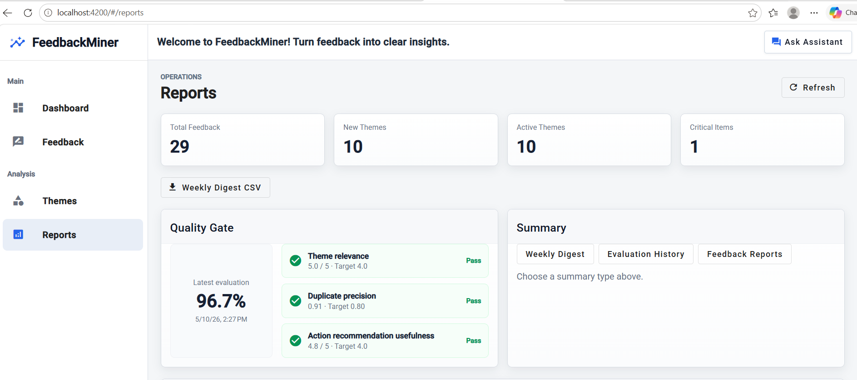
Screenshots
Portal ID | Name | Email
348511 | Abhipsha Satpathy | Abhipsha.Satpathy@nttdata.com
347092 | Mahima Munjal | Mahima.Munjal@nttdata.com
221019 | Mahima V Bhandari | Mahima.Bhandari@nttdata.com
345559 | Supriya Ghadge | GhadgeSupriya.Kailas@nttdata.com
356468 | Satya P Arya | SatyaPrakash.Arya@nttdata.com
© 2026 NTT DATA, Inc.

